Slide 1
The European Green Deal
The Just Transition Fund
Monitoring Committee ROP Mazowieckie Warsaw, 16 January 2020
Christopher Todd, Head of Unit F3 Poland
European Commission DG REGIO

Slide 2
Urgency of climate action
    Without action on climate change, the EU will see, in the timelife of our children:
    400,000 premature deaths per yer due to air pollution
    90,000 annual deaths due to heatwaves
    16% of species in risk of extinction
    40% less available water in southern part of the EU
    500,000 people exposed to river flooding per year
    2,2 million people exposed to coastal inundation each year
    The longer we wait, the harder it becomes to reach low temperature targets and the more expensive the necessary efforts will become

Slide 3
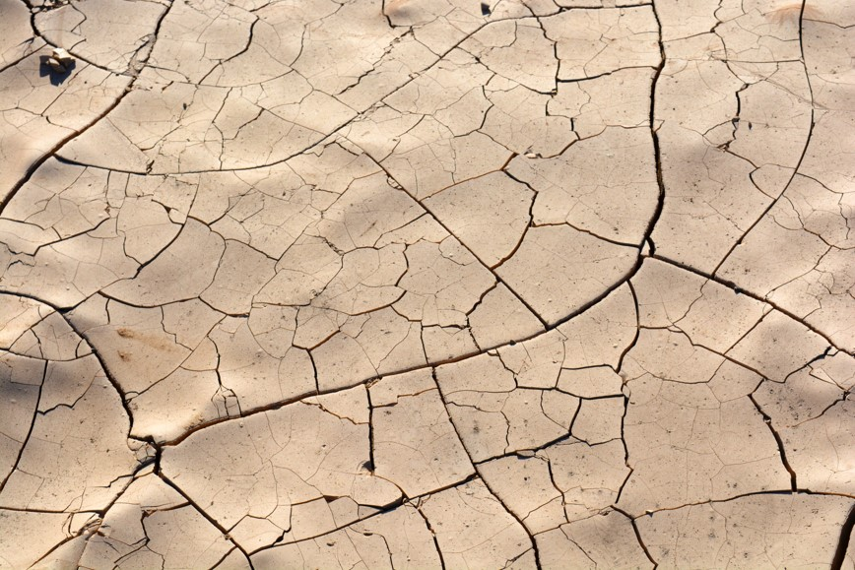
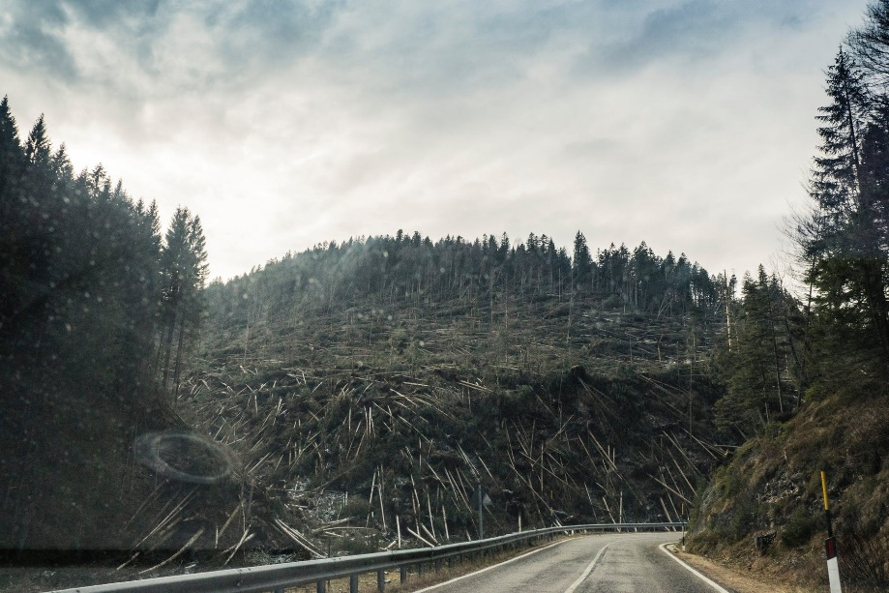
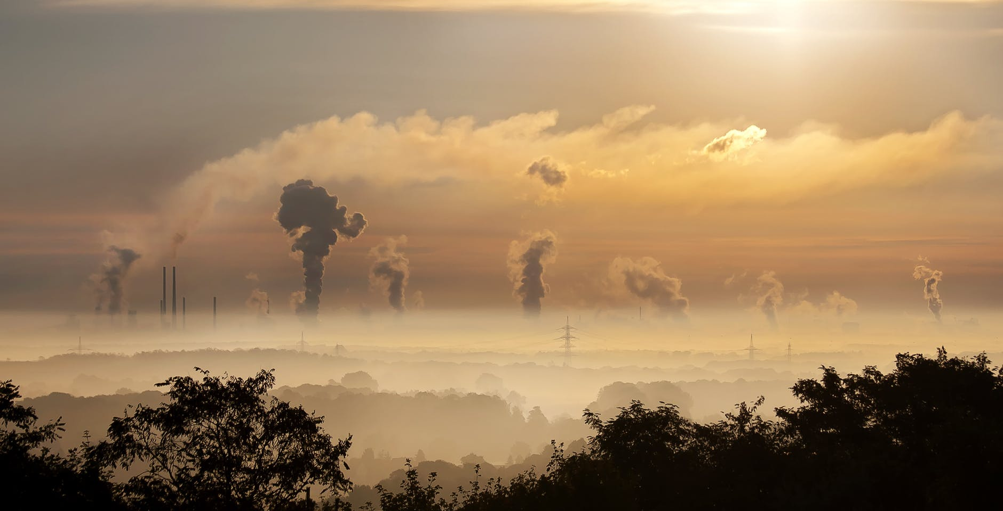
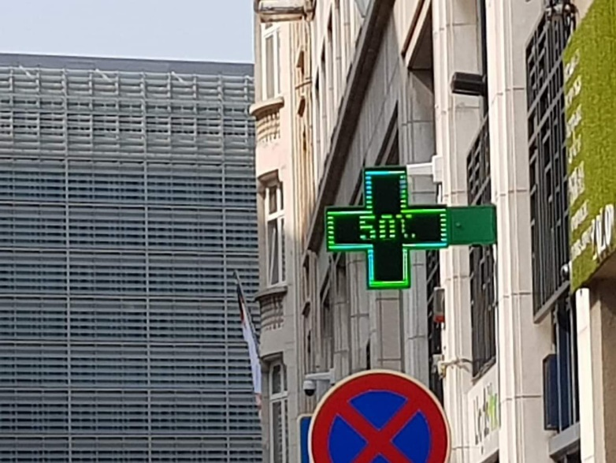
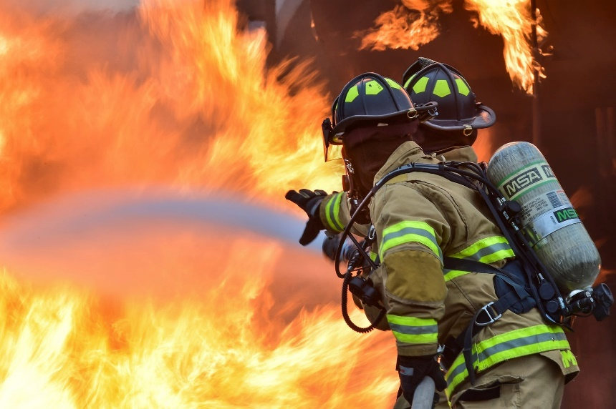

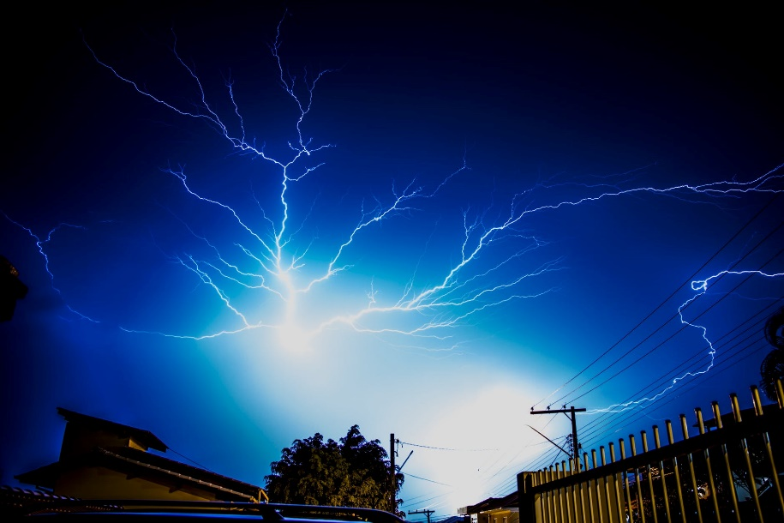
Extreme weather events
www.pexels.com

Slide 4
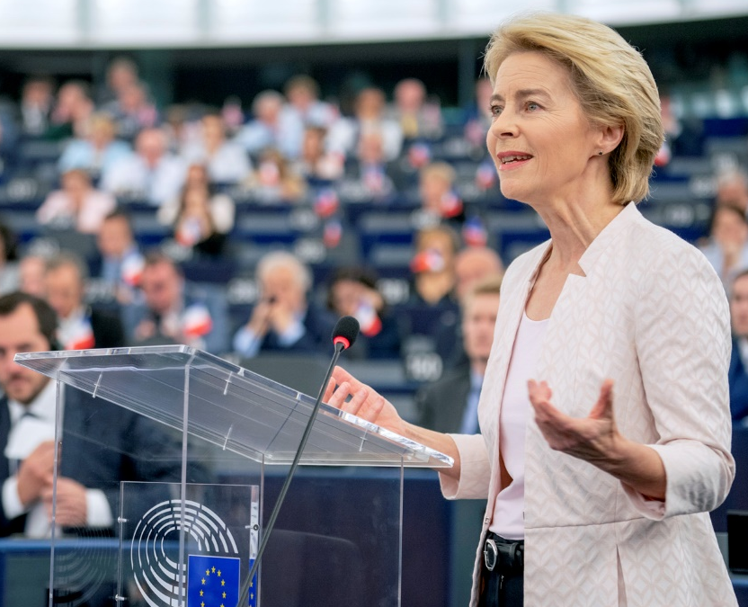
Key ambition of the Commission
    “Europe must lead the transition to a healthy planet and a new digital world. But it can only do so by bringing people together and upgrading our unique social market economy to fit today’s new ambitions”
    (Ursula von der Leyen, Political guidelines for the next EC 2019-2024)
    Headline ambition: A European Green Deal
      Global leadership: world’s first climate-neutral continent
      Biodiversity Strategy 2030
      New Circular Economy Action Plan
      Just transition: cohesion policy, Just Transition Fund
      Sustainable European Investment Plan
      Future-ready economy – new industrial strategy

Slide 5
Source: Twitter @TimmermansEU, 8 October 2019

Slide 6
Political framework
European Green Deal Communication
Sustainable Europe Investment Plan
Just Transition Mechanism
Just Transition Fund
Invest EU
EIB lending

Slide 7
Just Transition Fund
    Created to support regions that depend on fossil fuels or that have carbon-intensive industries, helping reduce the impact of their transition towards climate neutrality
    Both new funding from the EU budget of 7.5 billion euro and dedicated funding from ERDF and ESF+, mobilizing up to 50 billion euro
    Spending will be based on territiorial transition plans (consistent with National Energy and Climate Plans), showing the outline of the transition process until 2030
    JTF is only one part of the Just Transition Mechanism, itself a component of the Sustainable Europe Investment Plan, which aims to mobilise EUR 1 trillion over the next 10 years

Slide 8
Just Transition Fund
The JTF will be programmed and managed in the same way as the cohesion policy funds
The JTF will focus on the economic diversification and reconversion of the territories concerned. This means, for example, support to companies i.e. productive investments in SMEs to diversify their activities but also support for creating new firms. In relation to this, re-skilling and job seeking assistance for workers should also be necessary, which the JTF can support. The JTF will also support investments for climate transition and environmental sustainability i.e. enhancing processes necessary for enhanced circular economy (waste reduction, resource efficiency, recycling etc).
    The programming process, including the identification of the territories for intervention and corresponding actions will be agreed in a dialogue between the Commission and each Member State. It will be steered by the European Semester process.

Slide 9





Thank you

