Slide 1
My Region, My Europe, Our Future the 7th Cohesion Report
Christopher Todd
Head of Unit
Poland

Slide 2
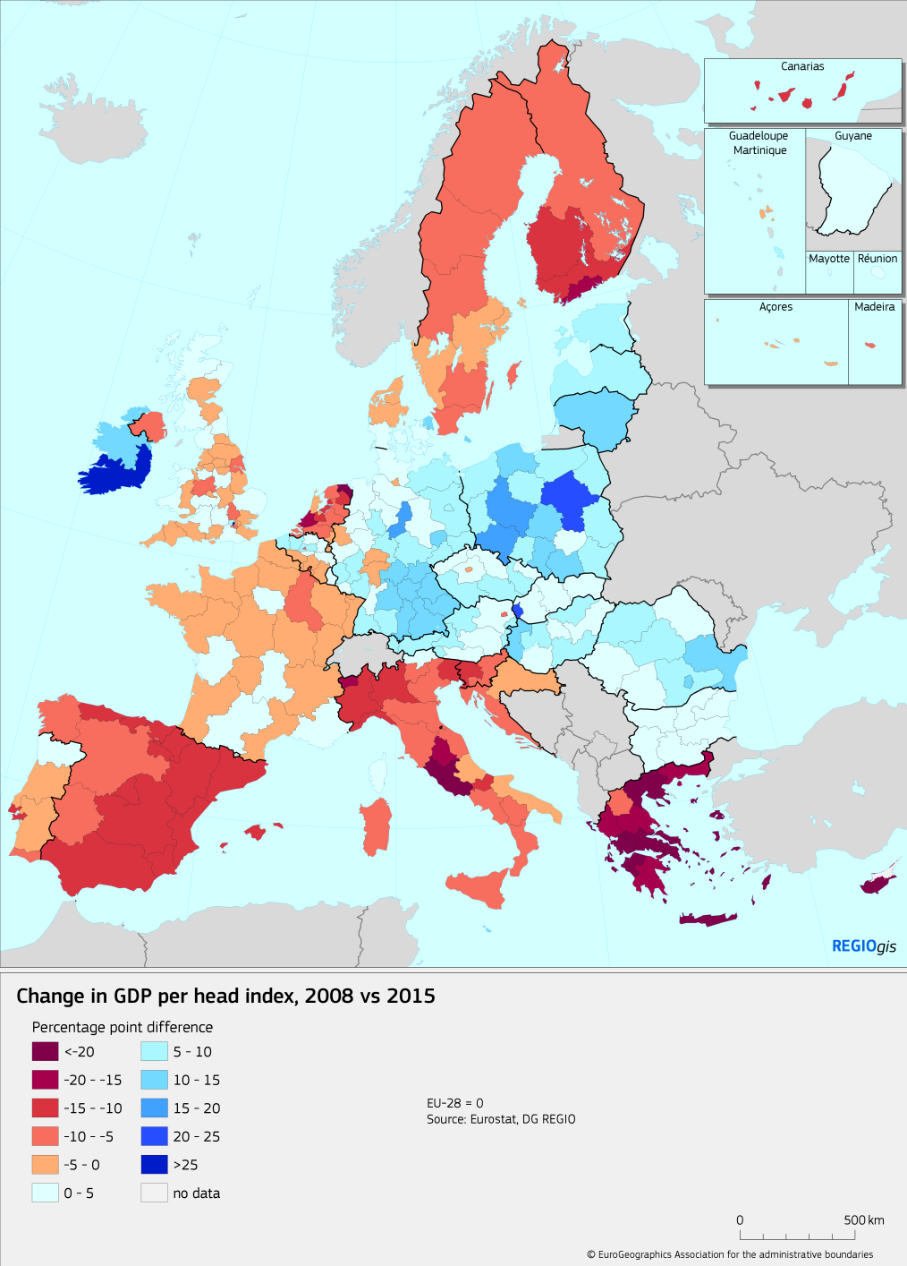
Economic cohesion
Regional disparities are narrowing again
Regions in eastern Member States have converged to the EU average, but Greek and Italian regions diverged substantially

Slide 3
Middle-income trap
Regions that do not move into the higher value added activities
Face growing competition from less developed regions
Innovation remains spatially concentrated
Competitive regions in the east generate few spillovers

Slide 4
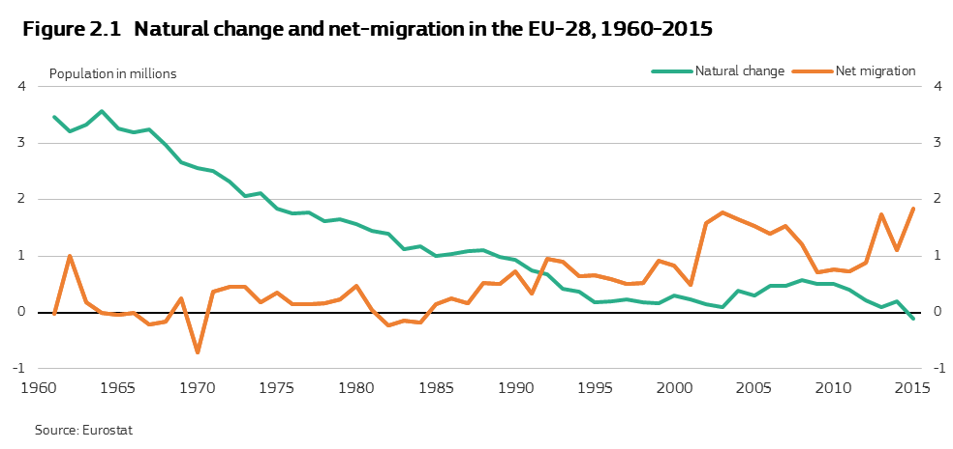
In 2015 deaths outnumbered births

Slide 5
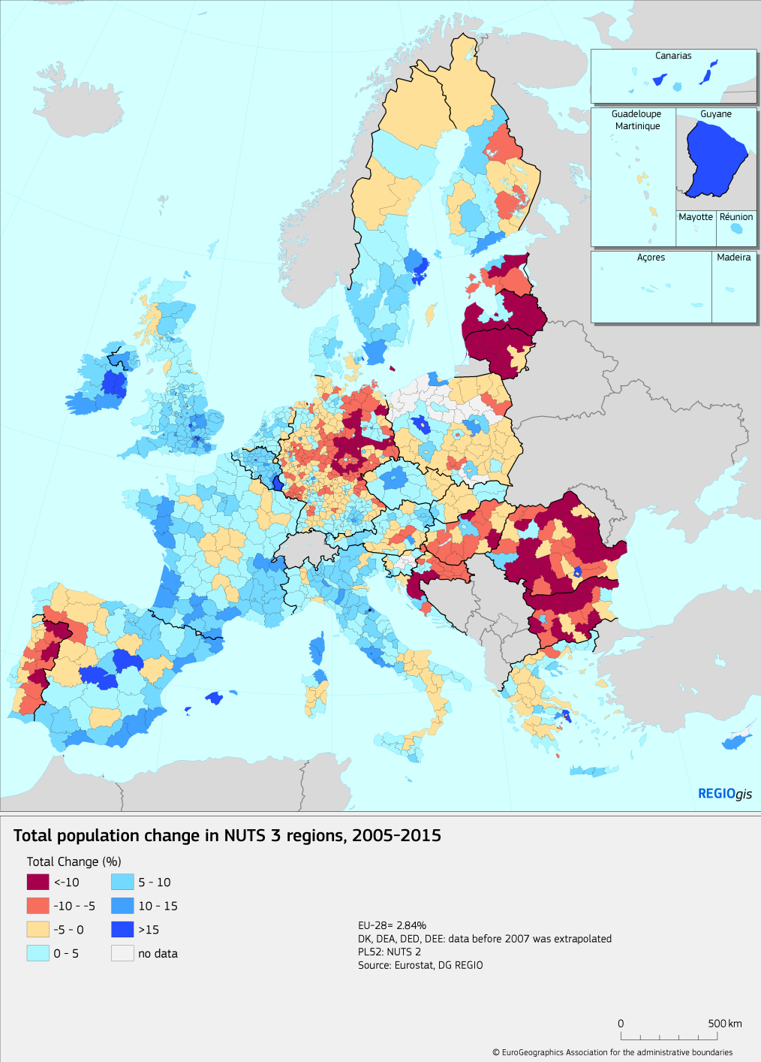
Migration & mobility
Migration and mobility is main determinant of population change
Two out of three people in EU-13 live in a shrinking NUTS 3 region

Slide 6
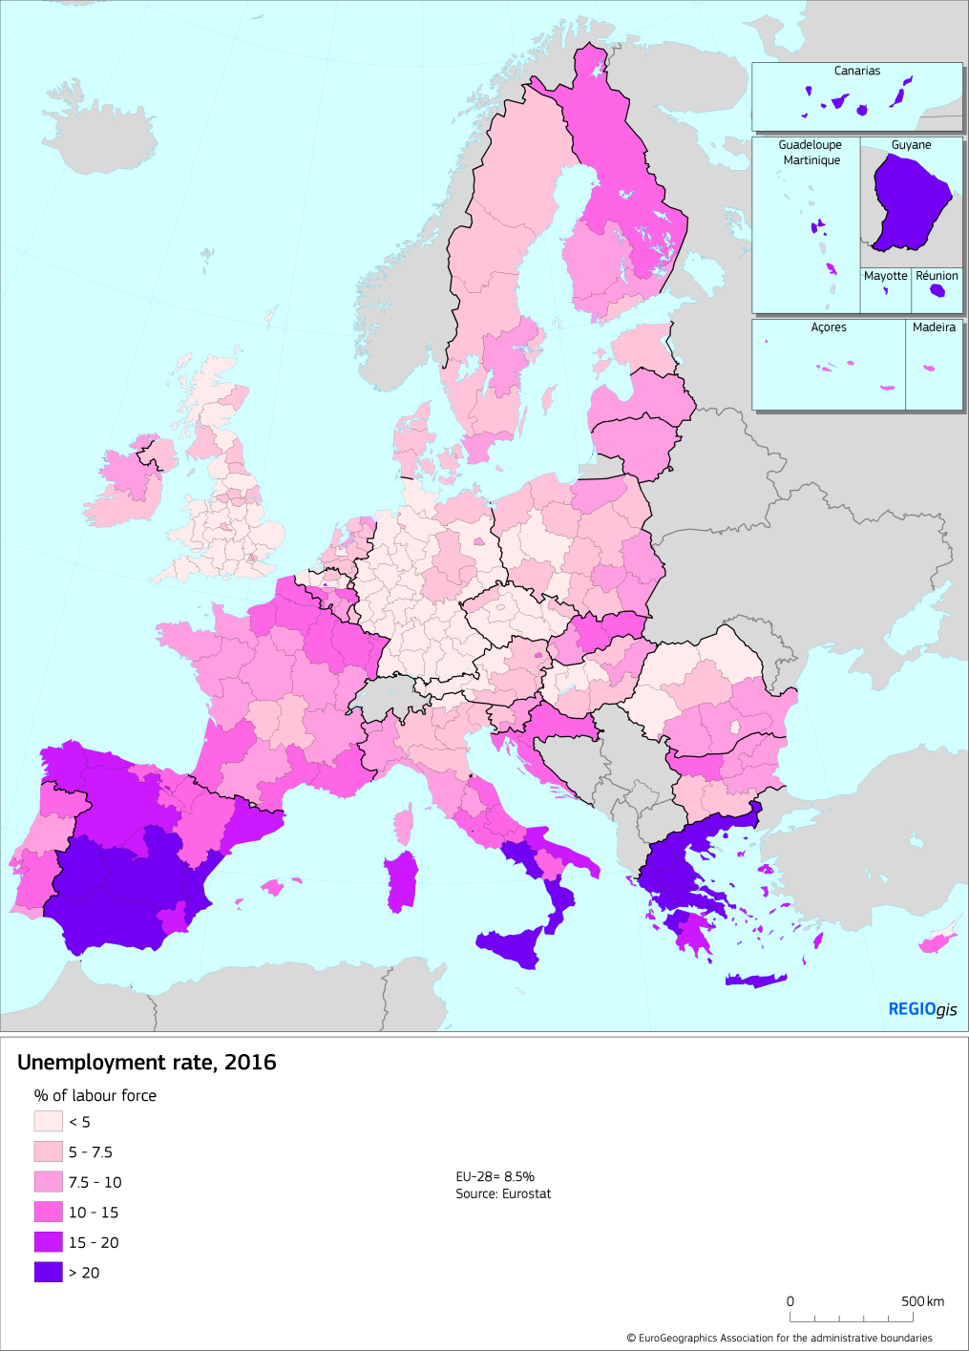
Unemployment
Unemployment is still above pre-crisis level and regional disparities have not started narrowing yet
In particular youth unemployment remains high

Slide 7
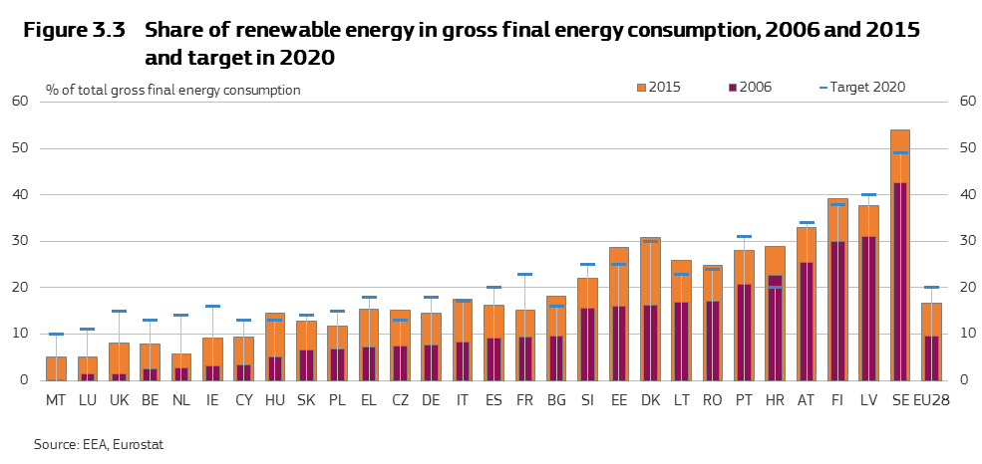
More investments needed to reach 2030 climate targets

Slide 8
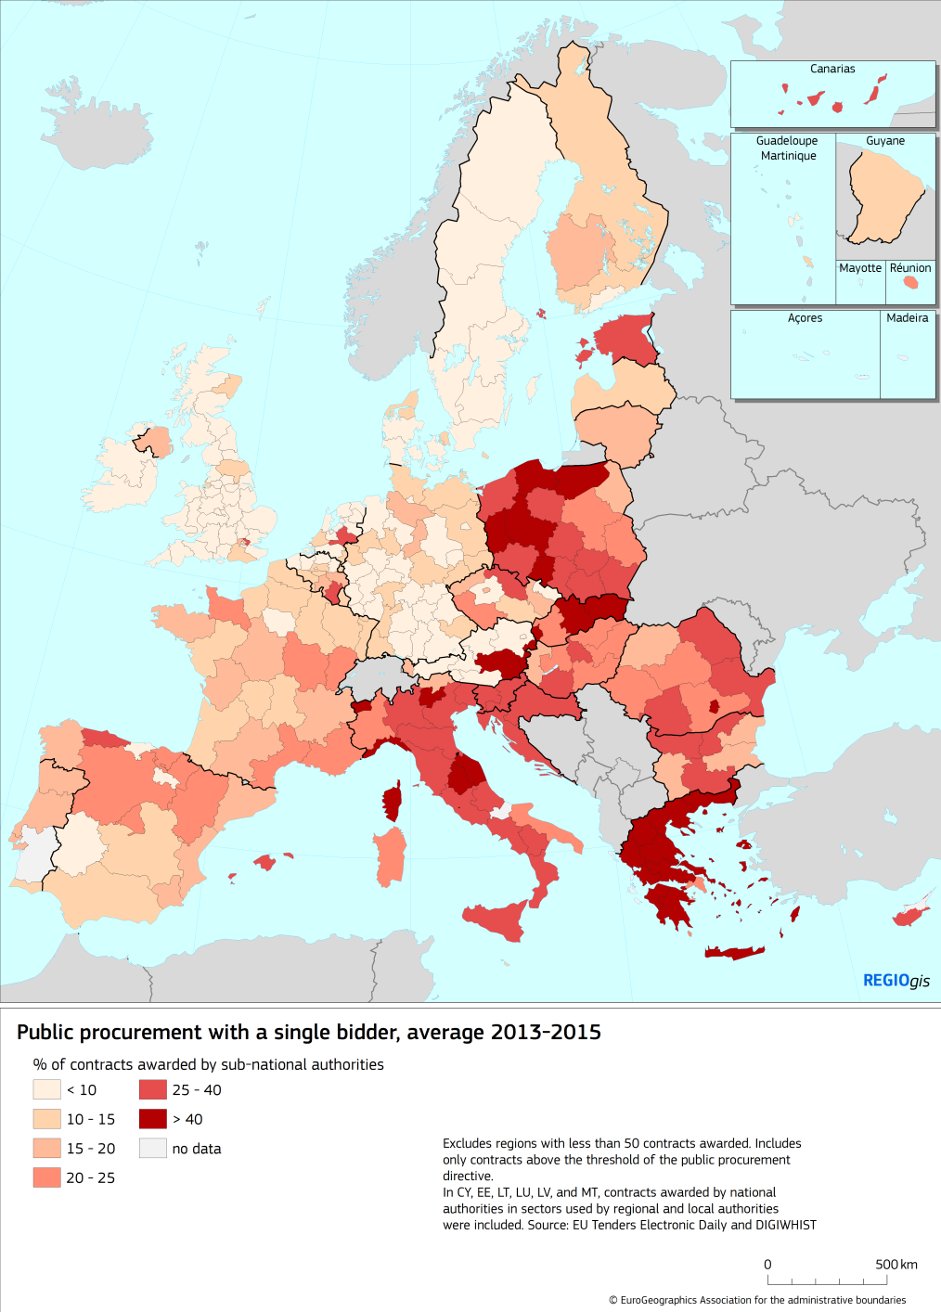
Limited competition
Too many contracts for single bidders
Not always collusion
Low value for money?
More e-procurement
Better information
More offers from outside the country

Slide 9
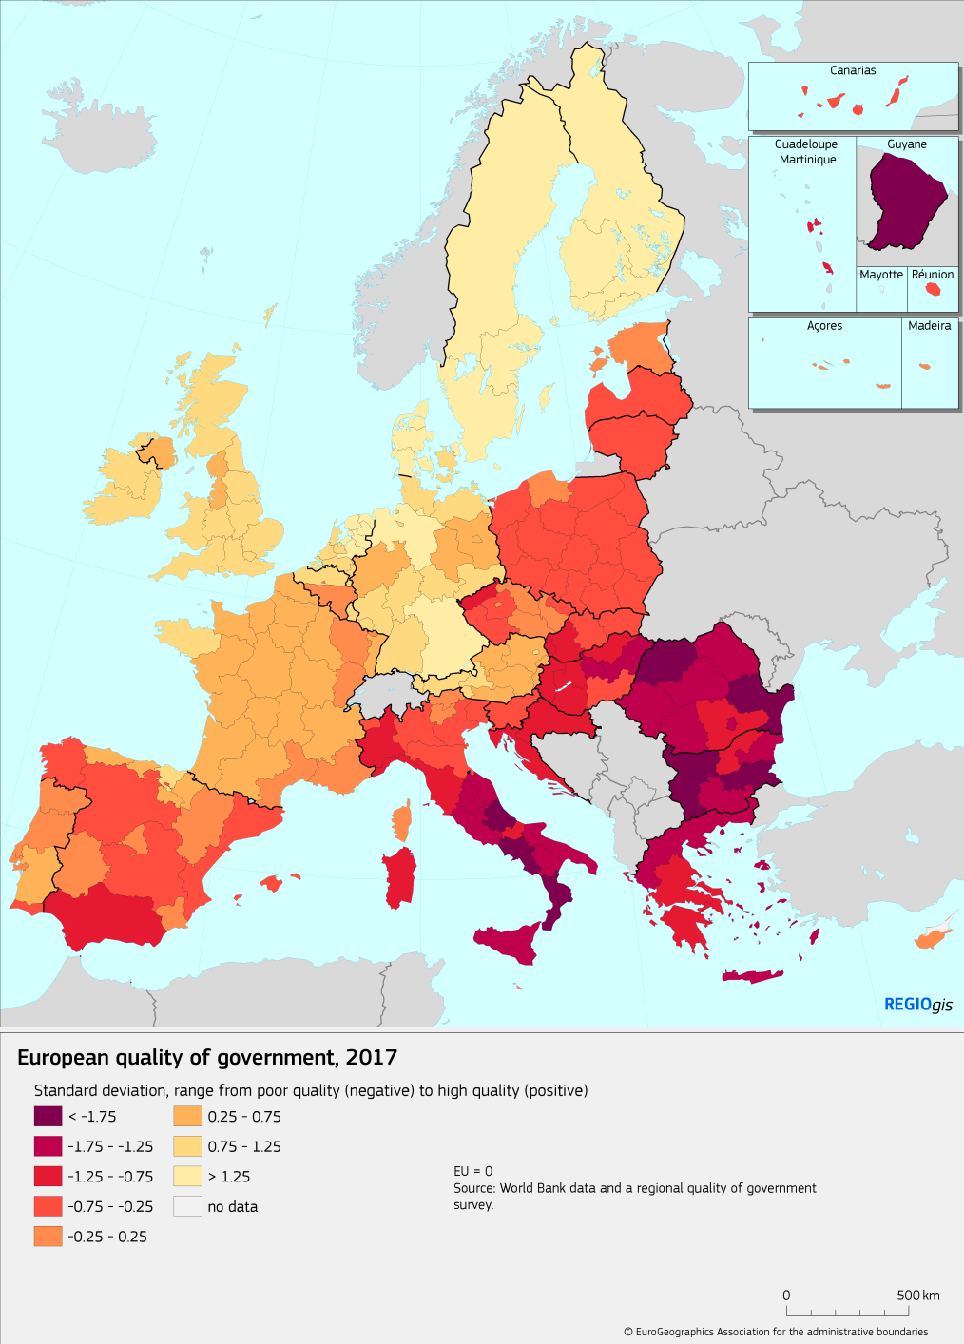
Improving institutions
The quality and impartiality of public services is uneven
Ease of doing business can be improved
E-Government can help

Slide 10
National policies and cohesion
Public investment as a share of GDP is still below the pre-crisis level.
Low investment in less developed MS can undermine convergence
No review needed at this stage to the link between Cohesion Policy and economic governance and the country specific recommendations

Slide 11
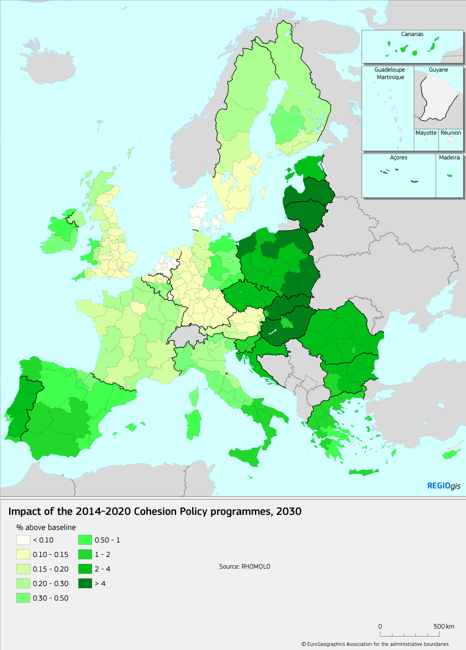
Impact of cohesion policy
8.5% of public investment in the EU and 41% in the EU-13
Boosts GDP by 3% in each in EU-13

Slide 12
Post 2020: Where to invest?
Main focus: Less developed & border regions
But also: areas undergoing industrial transition, rural areas, the outermost regions, areas of high unemployment and deprived urban areas
Full coverage in the last two periods
The impact of globalisation, migration, poverty, a lack of innovation, climate change, energy transition and pollution is not limited to less developed regions

Slide 13
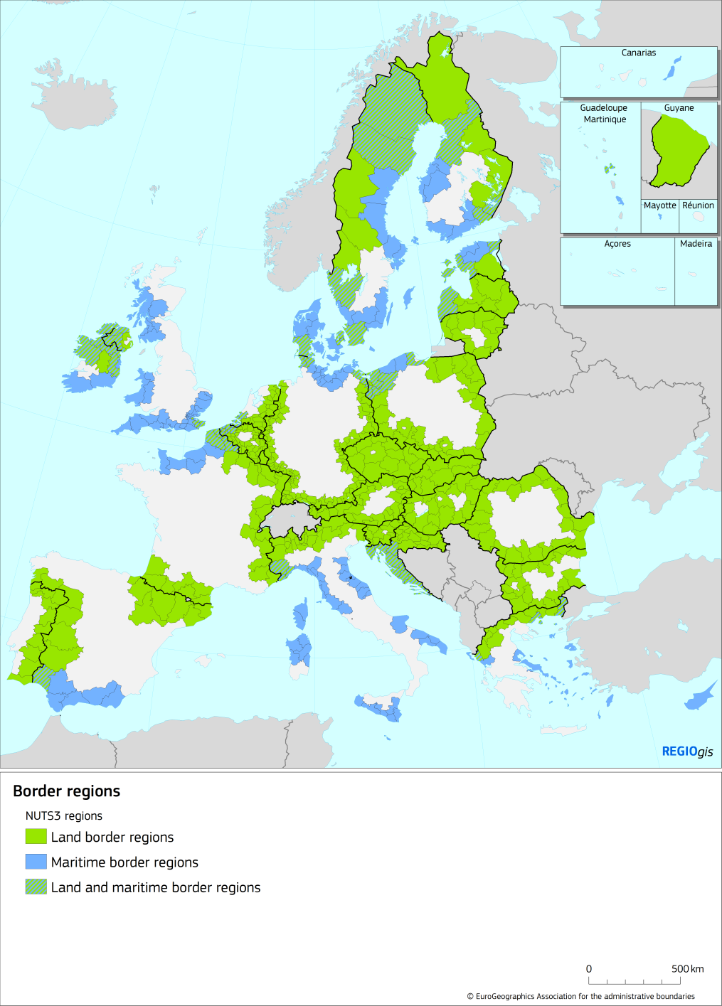
Resolve cross-border problems
such as gaps and missing links in different policy fields, including transport
pooling of joint public services?

Slide 14
Post 2020: Investment priorities
Social inclusion, employment, skills, innovation, climate change, energy and environmental transition
Reflection paper mentions positive impact of CP on SMEs, healthcare and social infrastructure, transport and digital infrastructure.
Improving institutions
Positive incentives for structural reform
Support to cooperation, especially on innovation

Slide 15
Post 2020: How to invest
A single rule book
Allocations linked to EU challenges and priorities
Higher national co-financing
An unallocated capacity to create flexibility
Faster implementation: N+2 and faster closure
Complementarity between financial instruments
A radical approach to simplification

Slide 16
Cohesion policy should
continue to reduce regional disparities,
stimulate investment in EU priorities,
address new challenges and
improve institutions.

